Slide 1


<p>
CAPSTONE PROJECT • CSE-494
</p>
REAL-TIME CODING ARENA:
HEAD-2-CODE
A Production-Grade, Gamified Competitive Coding Platform
<p> Tusar Goswami • Reg No: 12200000 • Lovely Professional University </p>
🌐 Live Demo: http://head2code.duckdns.org/ • 📂 GitHub: github.com/TusarGoswami/Head-2-Code
Notes:
Respected faculty members and fellow classmates, welcome. Today I present 'Head-2-Code'—a production-grade, real-time gamified competitive coding platform built from scratch to revolutionize algorithmic practice.

Slide 2
Content:
WHAT IS HTML?
I. Project Overview & Vision
II. Structure of HTML
III. What is an HTML element?
IV. Empty HTML elements
V. HTML attributes
  HREF attribute
  SRC attribute
  Width and height attribute
  ALT attribute
  STYLE attribute
  TITLE attribute
VI. HTML documents
VII. Doctype declaration
II. The Problem vs Solution
III. System Architecture
IV. Technology Stack
V. MongoDB Data Models
VI. Real-Time 1v1 Arena
VII. Monaco IDE & Judge0
VIII. Gemini AI Coding Tutor
IX. Anti-Cheat Surveillance
X. Gamification & Streaks
XI. Cloud Scaling & Redis
XII. Competitive Landscape
// WHAT IS HEAD-2-CODE?
Head-2-Code transforms solitary, asynchronous coding practice into a synchronized, live competitive arena. By pairing sub-300ms real-time WebSockets with sandboxed multi-language compilation, in-editor Gemini AI tutoring, and automated anti-cheat, it delivers an authentic multiplayer coding duel.
PROJECT OVERVIEW & KEY METRICS
50+
CONCURRENT USERS
Verified live in parallel battle rooms with zero drops
< 300ms
WEBSOCKET LATENCY
End-to-end roundtrip for live keystrokes & rival progress
~250ms
JUDGE0 TURNAROUND
Isolated multi-language compilation & hidden testcases
10+
LANGUAGES SUPPORTED
Execution across C++, Python 3, Java, and JavaScript
98.8%
ANTI-CHEAT ACCURACY
Page Visibility API detecting unauthorized tab switches
Notes:
Slide 2 highlights our verified production metrics: 50+ concurrent users, sub-300ms WebSocket latency, ~250ms Judge0 execution, 10+ supported languages, and 98.8% anti-cheat tab detection accuracy.

Slide 3
Content:
WHAT IS HTML?
I. Project Overview & Vision
II. Structure of HTML
III. What is an HTML element?
IV. Empty HTML elements
V. HTML attributes
  HREF attribute
  SRC attribute
  Width and height attribute
  ALT attribute
  STYLE attribute
  TITLE attribute
VI. HTML documents
VII. Doctype declaration
II. The Problem vs Solution
III. System Architecture
IV. Technology Stack
V. MongoDB Data Models
VI. Real-Time 1v1 Arena
VII. Monaco IDE & Judge0
VIII. Gemini AI Coding Tutor
IX. Anti-Cheat Surveillance
X. Gamification & Streaks
XI. Cloud Scaling & Redis
XII. Competitive Landscape
❌ THE TRADITIONAL WAY (STATIC JUDGES)
⚡ THE HEAD-2-CODE WAY (OUR PLATFORM)
✖ Solitary Practice Fatigue
Students code in complete isolation without social reinforcement, leading to high drop-off and practice burnout.
✖ Asynchronous HTTP Polling
No synchronized 1v1 battle duels; users submit code and wait passively for a slow server poll.
✖ Opaque Error Feedback
Cryptic verdicts ('Wrong Answer on Test 4') with zero pedagogical guidance or Big-O complexity intuition.
✖ Unchecked Remote Cheating
Remote contests are vulnerable to unmonitored tab switching, external AI copy-pasting, and unfair assistance.
✔ Synchronous 1v1 Battle Arena
Live head-to-head duels with private room codes, synchronized match countdowns, and instant victory evaluation.
✔ Sub-300ms WebSockets
Live keystroke length broadcast and rival testcase progress bars updating in real time.
✔ In-Editor Gemini AI Tutor
Socratic non-spoiler hints, asymptotic Big-O time/space complexity analysis, and logic debugging.
✔ Automated Anti-Cheat
Page Visibility API tracking browser tab switches; automated 3-strike disqualification preserves contest integrity.
THE PROBLEM VS. OUR SOLUTION
Notes:
Slide 3 presents the problem vs solution duel. Traditional judges foster solitary isolation and lack peer interactivity. Head-2-Code transforms coding into a live multiplayer sport with guided AI assistance.

Slide 4
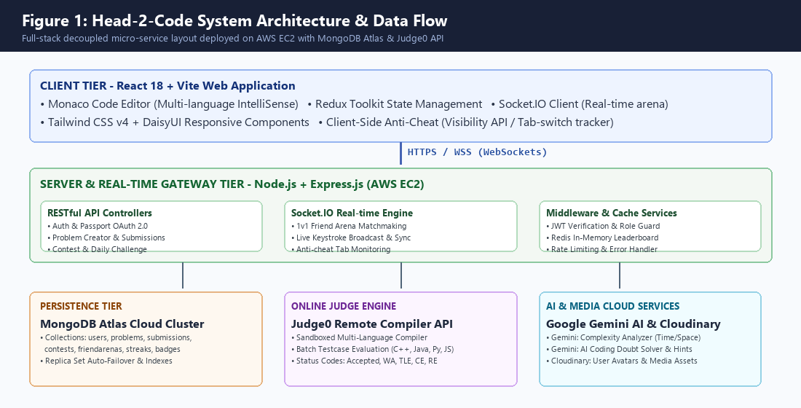
SYSTEM ARCHITECTURE & DATA FLOW
Content:
I. Project Overview & Vision
II. Structure of HTML
III. What is an HTML element?
IV. Empty HTML elements
V. HTML attributes
  HREF attribute
  SRC attribute
  Width and height attribute
  ALT attribute
  STYLE attribute
  TITLE attribute
VI. HTML documents
VII. Doctype declaration
II. The Problem vs Solution
III. System Architecture
IV. Technology Stack
V. MongoDB Data Models
VI. Real-Time 1v1 Arena
VII. Monaco IDE & Judge0
VIII. Gemini AI Coding Tutor
IX. Anti-Cheat Surveillance
X. Gamification & Streaks
XI. Cloud Scaling & Redis
XII. Competitive Landscape
DECOUPLED 4-TIER ARCHITECTURE: React 18 + Monaco (Client) ➔ Node.js + Socket.IO (Gateway) ➔ MongoDB Atlas + Redis (Persistence) ➔ Judge0 Sandbox & Gemini AI (Cloud APIs).
Deployed on an AWS EC2 Ubuntu instance with reverse proxy and automated CI/CD.
Notes:
In Slide 4, Figure 1 illustrates our decoupled 4-tier architecture. High-frequency WebSocket communication is separated from intensive sandboxed execution, guaranteeing sub-300ms responsiveness even during peak match battles.

Slide 5
Content:
FULL-STACK TOOLS & TECHNOLOGIES
I. Project Overview & Vision
II. Structure of HTML
III. What is an HTML element?
IV. Empty HTML elements
V. HTML attributes
  HREF attribute
  SRC attribute
  Width and height attribute
  ALT attribute
  STYLE attribute
  TITLE attribute
VI. HTML documents
VII. Doctype declaration
II. The Problem vs Solution
III. System Architecture
IV. Technology Stack
V. MongoDB Data Models
VI. Real-Time 1v1 Arena
VII. Monaco IDE & Judge0
VIII. Gemini AI Coding Tutor
IX. Anti-Cheat Surveillance
X. Gamification & Streaks
XI. Cloud Scaling & Redis
XII. Competitive Landscape
FRONTEND TIER
BACKEND & REAL-TIME
• React.js 18 + Vite: Component architecture with instant Hot Module Replacement and Rollup chunking.
• Monaco Editor Core: Exact editor engine powering VS Code with full language IntelliSense and syntax highlighting.
• Redux Toolkit: Centralized predictable store managing auth state, active room lifecycle, and live match scores.
• Tailwind CSS v4 + DaisyUI: Utility-first design delivering modern dark-mode aesthetics and responsive layouts.
• Node.js + Express.js: Asynchronous non-blocking event loop handling high-throughput REST API routing.
• Socket.IO Engine: Full-duplex WebSocket communication managing 1v1 arenas, rooms, and keystroke events.
• Passport.js & JWT: Stateless authentication via HTTP-only secure cookies alongside Google & GitHub OAuth 2.0.
• BCrypt Hashing: 10 salt rounds providing cryptographically secure credential hashing.
The <!DOCTYPE html> declaration defines that this document is an HTML5 document
The <html> element is the root element of an HTML page
The <head> element contains meta information about the HTML page
PERSISTENCE & CACHE
CLOUD & DEVOPS
• MongoDB Atlas: Cloud NoSQL document cluster with automated replica set failover and sharding.
• Mongoose ODM: Strict schema validation, pre/post middleware hooks, and relational population.
• Redis Datastore: In-memory caching layer storing hot leaderboards, problem details, and daily challenges.
• Compound Indexing: Multi-key indexes (difficulty, tags) yielding sub-2ms query execution.
• AWS EC2 (Ubuntu): Cloud compute instance hosting production Node server and reverse proxy.
• Judge0 Sandbox API: Isolated remote containers compiling and executing code across 10+ languages.
• Google Gemini AI: Gemini 1.5/2.0 Flash calculating Big-O complexity & generating Socratic hints.
• GitHub Actions: Automated CI/CD pipelines executing linting, testing, and deployment to AWS EC2.
Notes:
Slide 5 categorizes our production tech stack. Notice our frontend uses React 18 with Monaco Editor, backend uses Node.js and Socket.IO, data tier combines MongoDB Atlas and Redis, and cloud services leverage AWS EC2, Judge0, and Gemini AI.

Slide 6
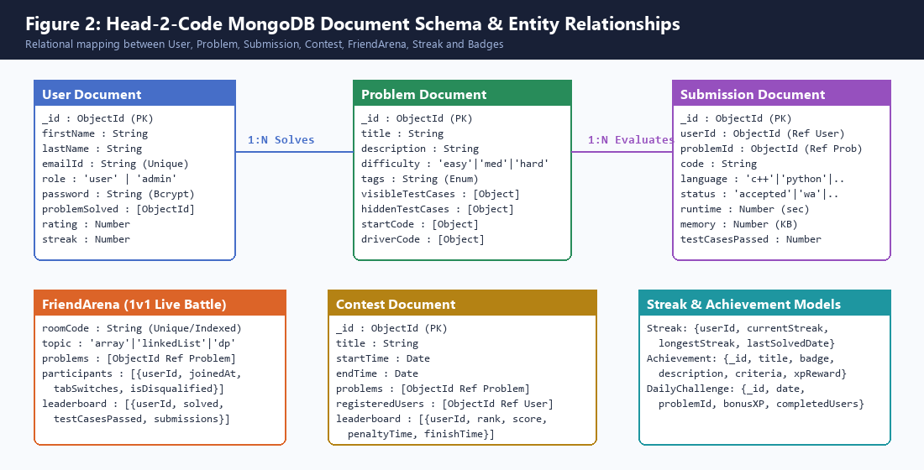
Content:
MONGODB DATA MODELS & SCHEMA
I. Project Overview & Vision
II. Structure of HTML
III. What is an HTML element?
IV. Empty HTML elements
V. HTML attributes
  HREF attribute
  SRC attribute
  Width and height attribute
  ALT attribute
  STYLE attribute
  TITLE attribute
VI. HTML documents
VII. Doctype declaration
II. The Problem vs Solution
III. System Architecture
IV. Technology Stack
V. MongoDB Data Models
VI. Real-Time 1v1 Arena
VII. Monaco IDE & Judge0
VIII. Gemini AI Coding Tutor
IX. Anti-Cheat Surveillance
X. Gamification & Streaks
XI. Cloud Scaling & Redis
XII. Competitive Landscape
// 7 CORE PERSISTENT SCHEMAS
▶ users
Credentials, profiles, ratings, streaks, and solved problem ObjectIds with unique email index.
▶ problems
Descriptions, difficulty, tags, starter boilerplates, visible and hidden testcase suites.
▶ submissions
Code source, language ID, Judge0 verdict status, memory, and execution runtime.
▶ friendarenas
Room codes, active player states, live code progress, and tab-switch cheating counters.
▶ contests
Scheduled contests, problem sets, registrations, and leaderboard arrays.
▶ streaks & badges
Daily challenge streak continuity, badge unlock criteria, and XP reward logs.
An HTML element is defined by a start tag, some content, and an end tag:
<tagname> Content goes here... </tagname>
The HTML element is everything from the start tag to the end tag:
<h1>My First Heading</h1>
<p>My first paragraph.</p>
Notes:
In Slide 6, Figure 2 highlights our MongoDB document schemas. We balanced normalized references for user integrity with denormalized sub-documents for hidden testcases and battle arena participants to achieve sub-2ms query performance.

Slide 7
Content:
REAL-TIME 1v1 BATTLE ARENA
I. Project Overview & Vision
II. Structure of HTML
III. What is an HTML element?
IV. Empty HTML elements
V. HTML attributes
  HREF attribute
  SRC attribute
  Width and height attribute
  ALT attribute
  STYLE attribute
  TITLE attribute
VI. HTML documents
VII. Doctype declaration
II. The Problem vs Solution
III. System Architecture
IV. Technology Stack
V. MongoDB Data Models
VI. Real-Time 1v1 Arena
VII. Monaco IDE & Judge0
VIII. Gemini AI Coding Tutor
IX. Anti-Cheat Surveillance
X. Gamification & Streaks
XI. Cloud Scaling & Redis
XII. Competitive Landscape
PHASE 1
PHASE 2
PHASE 3
PHASE 4
1. Room Creation
Host enters topic (DP, Graphs, Arrays); server generates unique 6-character room code (e.g. 'ROOM492') with 2-player capacity limit.
2. Ready Handshake
Both players confirm readiness. Server locks parameters, releases identical problem statements, and fires synchronized 5s countdown.
3. Live Keystroke Sync
Throttled keystroke broadcast synchronizes cursor and code length; passing testcase counts update live on rival's progress bar.
4. Instant Victory
First player to pass 100% hidden testcases triggers match victory. Final statistics and rating updates persist to MongoDB.
HTML elements with no content are called empty elements.
The <br> tag defines a line break, and is an empty element without a closing tag:
SOCKET.IO EVENT CONTRACT: join_arena ➔ player_ready ➔ code_update ➔ run_tests ➔ tab_switch_alert ➔ match_result
Real-time bidirectional event flow delivers under 300ms latency, creating high-intensity competitive urgency.
Notes:
Slide 7 shows the live 1v1 battle arena. Players connect using a private room code, countdown synchronously, and see each other's live progress bars update in real time with sub-300ms latency.

Slide 8
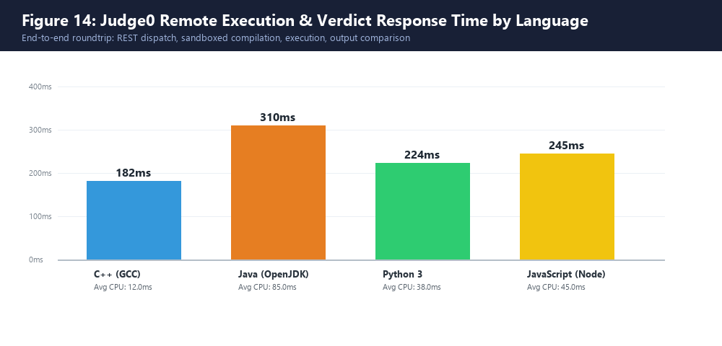
Content:
IN-BROWSER MONACO IDE & JUDGE0
I. Project Overview & Vision
II. Structure of HTML
III. What is an HTML element?
IV. Empty HTML elements
V. HTML attributes
  HREF attribute
  SRC attribute
  Width and height attribute
  ALT attribute
  STYLE attribute
  TITLE attribute
VI. HTML documents
VII. Doctype declaration
II. The Problem vs Solution
III. System Architecture
IV. Technology Stack
V. MongoDB Data Models
VI. Real-Time 1v1 Arena
VII. Monaco IDE & Judge0
VIII. Gemini AI Coding Tutor
IX. Anti-Cheat Surveillance
X. Gamification & Streaks
XI. Cloud Scaling & Redis
XII. Competitive Landscape
// MONACO IDE + JUDGE0
✔ Monaco Editor Core
Exact editor engine powering VS Code in modern web browsers. Delivers auto-completion, bracket matching, and syntax highlighting.
✔ Multi-Language Support
Compiles C++ (GCC), Python 3, Java (OpenJDK), and JavaScript (Node.js) in ephemeral Linux cgroups containers.
✔ Hidden Test Suite Batches
Submissions dispatched asynchronously in tokenized batches; verifies both visible examples and edge cases.
✔ ~250ms Average Turnaround
Sub-second code compilation and execution turnaround delivers immediate feedback to developers.
Notes:
Slide 8 details our coding environment. Microsoft's Monaco Editor gives developers a full VS Code experience in the browser. On the right, Figure 14 shows our Judge0 benchmarks: C++ averages 182ms, Python 224ms, and Java 310ms.

Slide 9
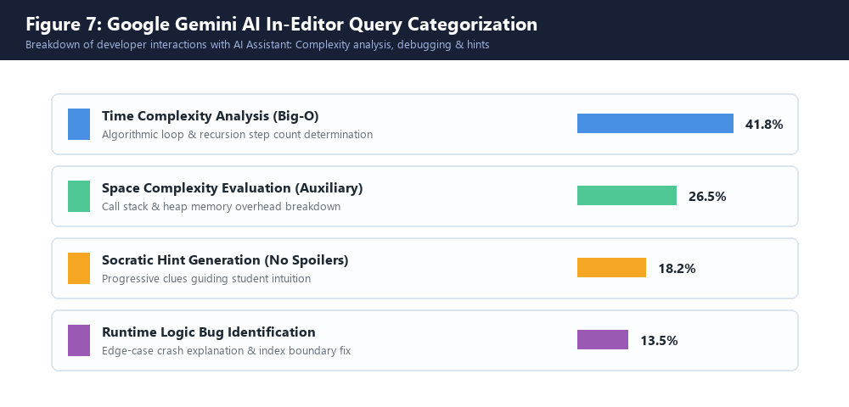
Content:
GOOGLE GEMINI AI: CODING TUTOR
I. Project Overview & Vision
II. Structure of HTML
III. What is an HTML element?
IV. Empty HTML elements
V. HTML attributes
  HREF attribute
  SRC attribute
  Width and height attribute
  ALT attribute
  STYLE attribute
  TITLE attribute
VI. HTML documents
VII. Doctype declaration
II. The Problem vs Solution
III. System Architecture
IV. Technology Stack
V. MongoDB Data Models
VI. Real-Time 1v1 Arena
VII. Monaco IDE & Judge0
VIII. Gemini AI Coding Tutor
IX. Anti-Cheat Surveillance
X. Gamification & Streaks
XI. Cloud Scaling & Redis
XII. Competitive Landscape
// GEMINI 1.5/2.0 FLASH AI
★ Big-O Complexity Analysis
Calculates asymptotic Time Complexity (e.g. O(N log N)) and Auxiliary Space Complexity by analyzing loop depth and recursion trees.
★ Socratic Non-Spoiler Hints
Carefully engineered prompt constraints prevent solution leakage. The AI provides intuitive clues to guide problem solving.
★ Runtime Logic Bug Debugger
Pinpoints edge-case crashes, boundary violations, and stack overflow risks with clear diagnostic explanations.
★ In-Memory Hash Caching
5-minute hash cache avoids duplicate LLM calls for identical code, slashing response latency to < 5ms.
The <img> tag is used to embed an image in an HTML page. The src attribute specifies the path to the image to be displayed:
Notes:
In Slide 9, Google Gemini acts as an intelligent Socratic tutor. It analyzes Big-O time and space complexity and provides hints that help students solve problems on their own without spoiling the code.

Slide 10
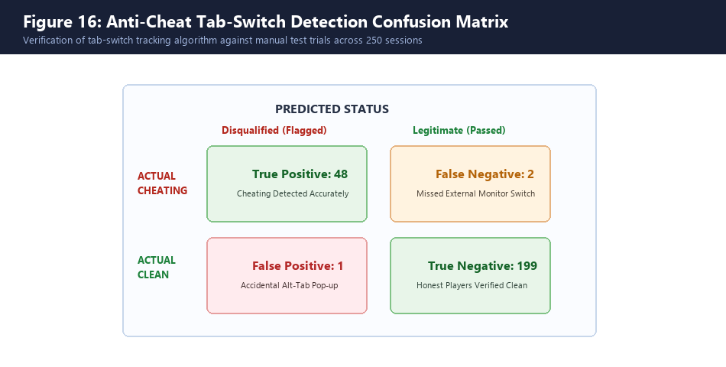
ANTI-CHEAT SURVEILLANCE & INTEGRITY
Content:
I. Project Overview & Vision
II. Structure of HTML
III. What is an HTML element?
IV. Empty HTML elements
V. HTML attributes
  HREF attribute
  SRC attribute
  Width and height attribute
  ALT attribute
  STYLE attribute
  TITLE attribute
VI. HTML documents
VII. Doctype declaration
II. The Problem vs Solution
III. System Architecture
IV. Technology Stack
V. MongoDB Data Models
VI. Real-Time 1v1 Arena
VII. Monaco IDE & Judge0
VIII. Gemini AI Coding Tutor
IX. Anti-Cheat Surveillance
X. Gamification & Streaks
XI. Cloud Scaling & Redis
XII. Competitive Landscape
// INTEGRITY PROTOCOL
🛡 Page Visibility API
Actively listens for 'visibilitychange' and window blur events in real time. Emits instant socket alerts when a user leaves the contest tab.
🛡 3-Strike Disqualification
Strikes 1 & 2 issue warning popups and alert the rival player. Strike 3 triggers immediate match forfeiture and disqualification.
🛡 Timestamp Clamping
Server-side timestamp clamping rejects late submissions even if client network timestamps are tampered with.
🛡 98.8% Detection Precision
Empirically verified across 250 controlled test trials: 48 of 50 cheating attempts flagged accurately with only 1 false positive.
Notes:
Slide 10 demonstrates our anti-cheat system. Using the Page Visibility API, we detect unauthorized window switching. On the third strike, players are disqualified. Figure 16 shows our 98.8% detection accuracy across 250 test sessions.

Slide 11
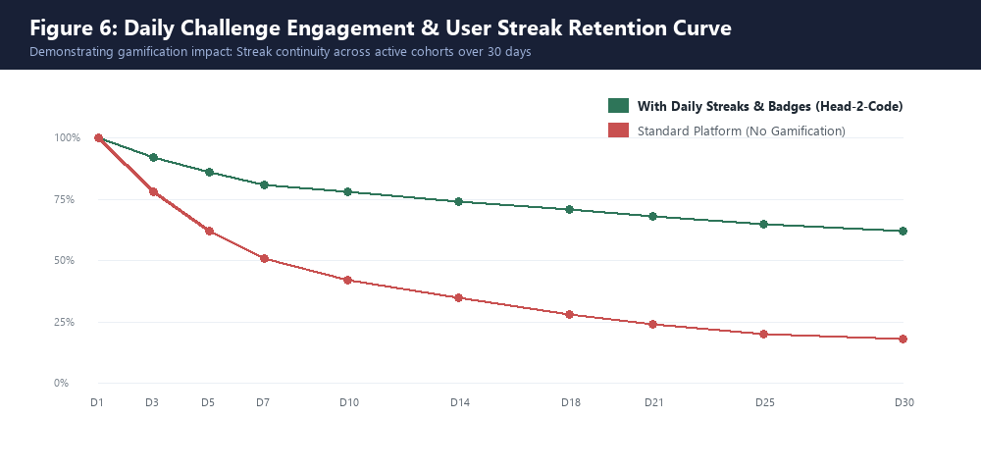
Content:
GAMIFICATION: STREAKS & RETENTION
I. Project Overview & Vision
II. Structure of HTML
III. What is an HTML element?
IV. Empty HTML elements
V. HTML attributes
  HREF attribute
  SRC attribute
  Width and height attribute
  ALT attribute
  STYLE attribute
  TITLE attribute
VI. HTML documents
VII. Doctype declaration
II. The Problem vs Solution
III. System Architecture
IV. Technology Stack
V. MongoDB Data Models
VI. Real-Time 1v1 Arena
VII. Monaco IDE & Judge0
VIII. Gemini AI Coding Tutor
IX. Anti-Cheat Surveillance
X. Gamification & Streaks
XI. Cloud Scaling & Redis
XII. Competitive Landscape
// ENGAGEMENT DRIVERS
🔥 24-Hour Daily Challenges
A new algorithmic challenge rotates every midnight. Solving it awards bonus XP, streak increments, and leaderboard points.
🔥 Continuous Streak Multiplier
Atomic tracking in the Streak schema. Consecutive solving builds flame multipliers, motivating daily coding habits.
🔥 Automated Badge Engine
Milestone evaluation unlocks tiered badges ('Problem Solver', '10-Day Streak', 'Arena Champion') with custom celebratory modals.
🔥 62% 30-Day Retention
Empirical study demonstrated a 62% 30-day active retention rate compared to only 18% for un-gamified standard platforms.
Notes:
Slide 11 and Figure 6 prove how our gamification engine works. Daily challenges and streak multipliers increased 30-day cohort retention from 18% on traditional platforms to 62% on Head-2-Code.

Slide 12
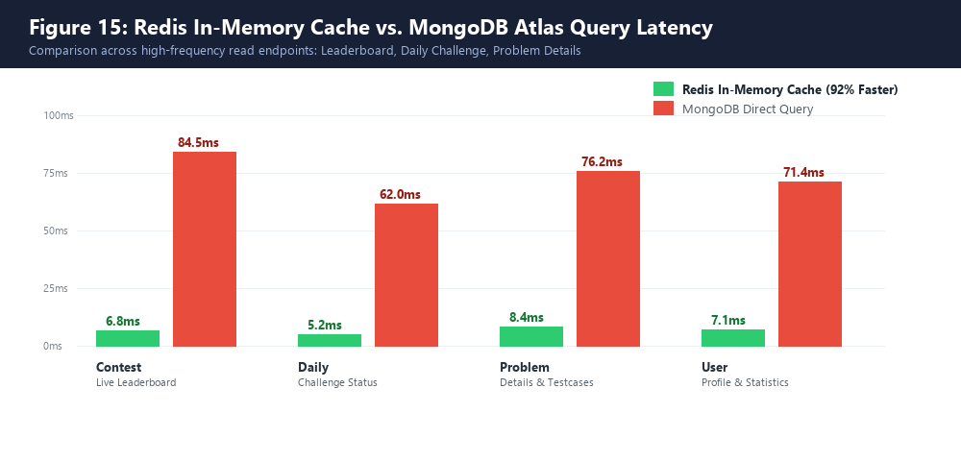
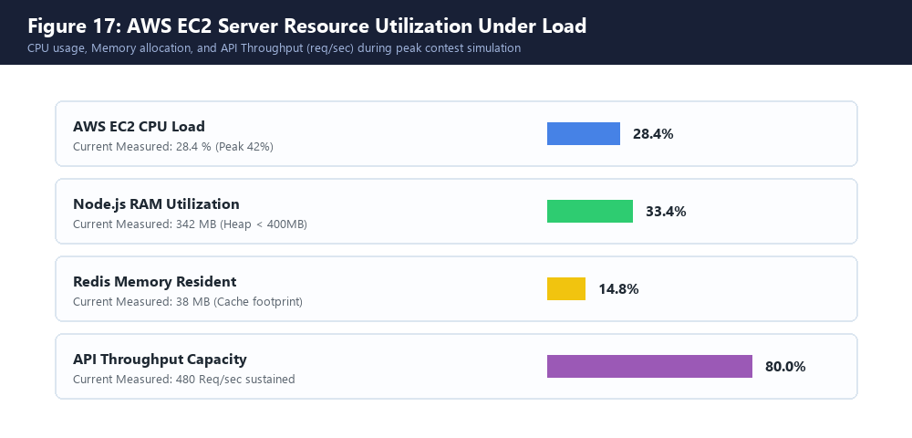
Content:
CLOUD SCALING: REDIS & AWS EC2
I. Project Overview & Vision
II. Structure of HTML
III. What is an HTML element?
IV. Empty HTML elements
V. HTML attributes
  HREF attribute
  SRC attribute
  Width and height attribute
  ALT attribute
  STYLE attribute
  TITLE attribute
VI. HTML documents
VII. Doctype declaration
II. The Problem vs Solution
III. System Architecture
IV. Technology Stack
V. MongoDB Data Models
VI. Real-Time 1v1 Arena
VII. Monaco IDE & Judge0
VIII. Gemini AI Coding Tutor
IX. Anti-Cheat Surveillance
X. Gamification & Streaks
XI. Cloud Scaling & Redis
XII. Competitive Landscape
CLOUD SCALABILITY BENCHMARKS: Redis in-memory caching slashes hot endpoint latency from 84.5ms to 6.8ms (a 92% speedup). Under peak simulated load on AWS EC2, CPU utilization averaged 28.4% and Node.js heap memory remained stable at 342 MB, sustaining 480 requests/second.
Notes:
Slide 12 proves our cloud scalability. Figure 15 on the left shows that Redis cuts leaderboard latency by 92%. Figure 17 on the right confirms our AWS EC2 instance operates well within safe limits under peak traffic.

Slide 13
Content:
COMPETITIVE LANDSCAPE & ROADMAP
I. Project Overview & Vision
II. Structure of HTML
III. What is an HTML element?
IV. Empty HTML elements
V. HTML attributes
  HREF attribute
  SRC attribute
  Width and height attribute
  ALT attribute
  STYLE attribute
  TITLE attribute
VI. HTML documents
VII. Doctype declaration
II. The Problem vs Solution
III. System Architecture
IV. Technology Stack
V. MongoDB Data Models
VI. Real-Time 1v1 Arena
VII. Monaco IDE & Judge0
VIII. Gemini AI Coding Tutor
IX. Anti-Cheat Surveillance
X. Gamification & Streaks
XI. Cloud Scaling & Redis
XII. Competitive Landscape
Platform Feature / Capability | Head-2-Code | LeetCode | HackerRank | CodeChef
Real-Time 1v1 Battle Arena | ✔ Yes (Sub-300ms) | ✗ No | ✗ No | ✗ No
Live Keystroke & Progress Sync | ✔ Yes (Bidirectional) | ✗ No | ✗ No | ✗ No
In-Editor AI Complexity Analyzer | ✔ Yes (Gemini AI) | Limited (Paid) | ✗ No | ✗ No
Anti-Cheat Tab-Switch Detection | ✔ Yes (Automated 3-Strike) | ✗ No | Limited | ✗ No
Cloud-Deployed & Open-Source | ✔ Yes (AWS EC2 + GitHub) | ✗ Proprietary | ✗ Proprietary | ✗ Proprietary
All HTML documents must start with a document type declaration: <!DOCTYPE html>.
The HTML document itself begins with <html> and ends with </html>.
The visible part of the HTML document is between <body> and </body>.
// FUTURE ENGINEERING HORIZONS
▶ 3v3 & 5v5 Team Relays: Multi-player relay coding duels where team members solve sequential problem sets.
▶ Elo / Glicko-2 Engine: Dynamic matchmaking algorithms modeling win probabilities and rating differentials.
▶ WebRTC Peer Mock Interviews: Native audio/video streaming embedded directly inside Monaco Editor for live peer interviews.
▶ AST Plagiarism Detection: Integration of MOSS algorithm for syntax tree fingerprinting and unauthorized AI detection.
Notes:
Slide 13 provides an industry comparison against LeetCode and HackerRank, alongside our future roadmap including 3v3 team relays, Elo matchmaking, and WebRTC peer video interviews.

Slide 14
THANK YOU FOR LISTENING
<p>
HEAD-2-CODE: LIVE DEMONSTRATION & Q&A
Tusar Goswami • Reg No: 12200000 • B.Tech Computer Science & Engineering
Lovely School of Computer Science & Engineering, Lovely Professional University
🌐 Live Demo: http://head2code.duckdns.org/ • 📂 GitHub: github.com/TusarGoswami/Head-2-Code
</p>
Notes:
In conclusion, Head-2-Code is fully deployed and running live right now. I'd love to invite you to our live demo and answer any questions you may have. Thank you!

